Slide 1
Design and testing of an SDN-based mitigation system to defeat slow-rate
DDoS attacks
Abraham Lemus Ruiz

Slide 2
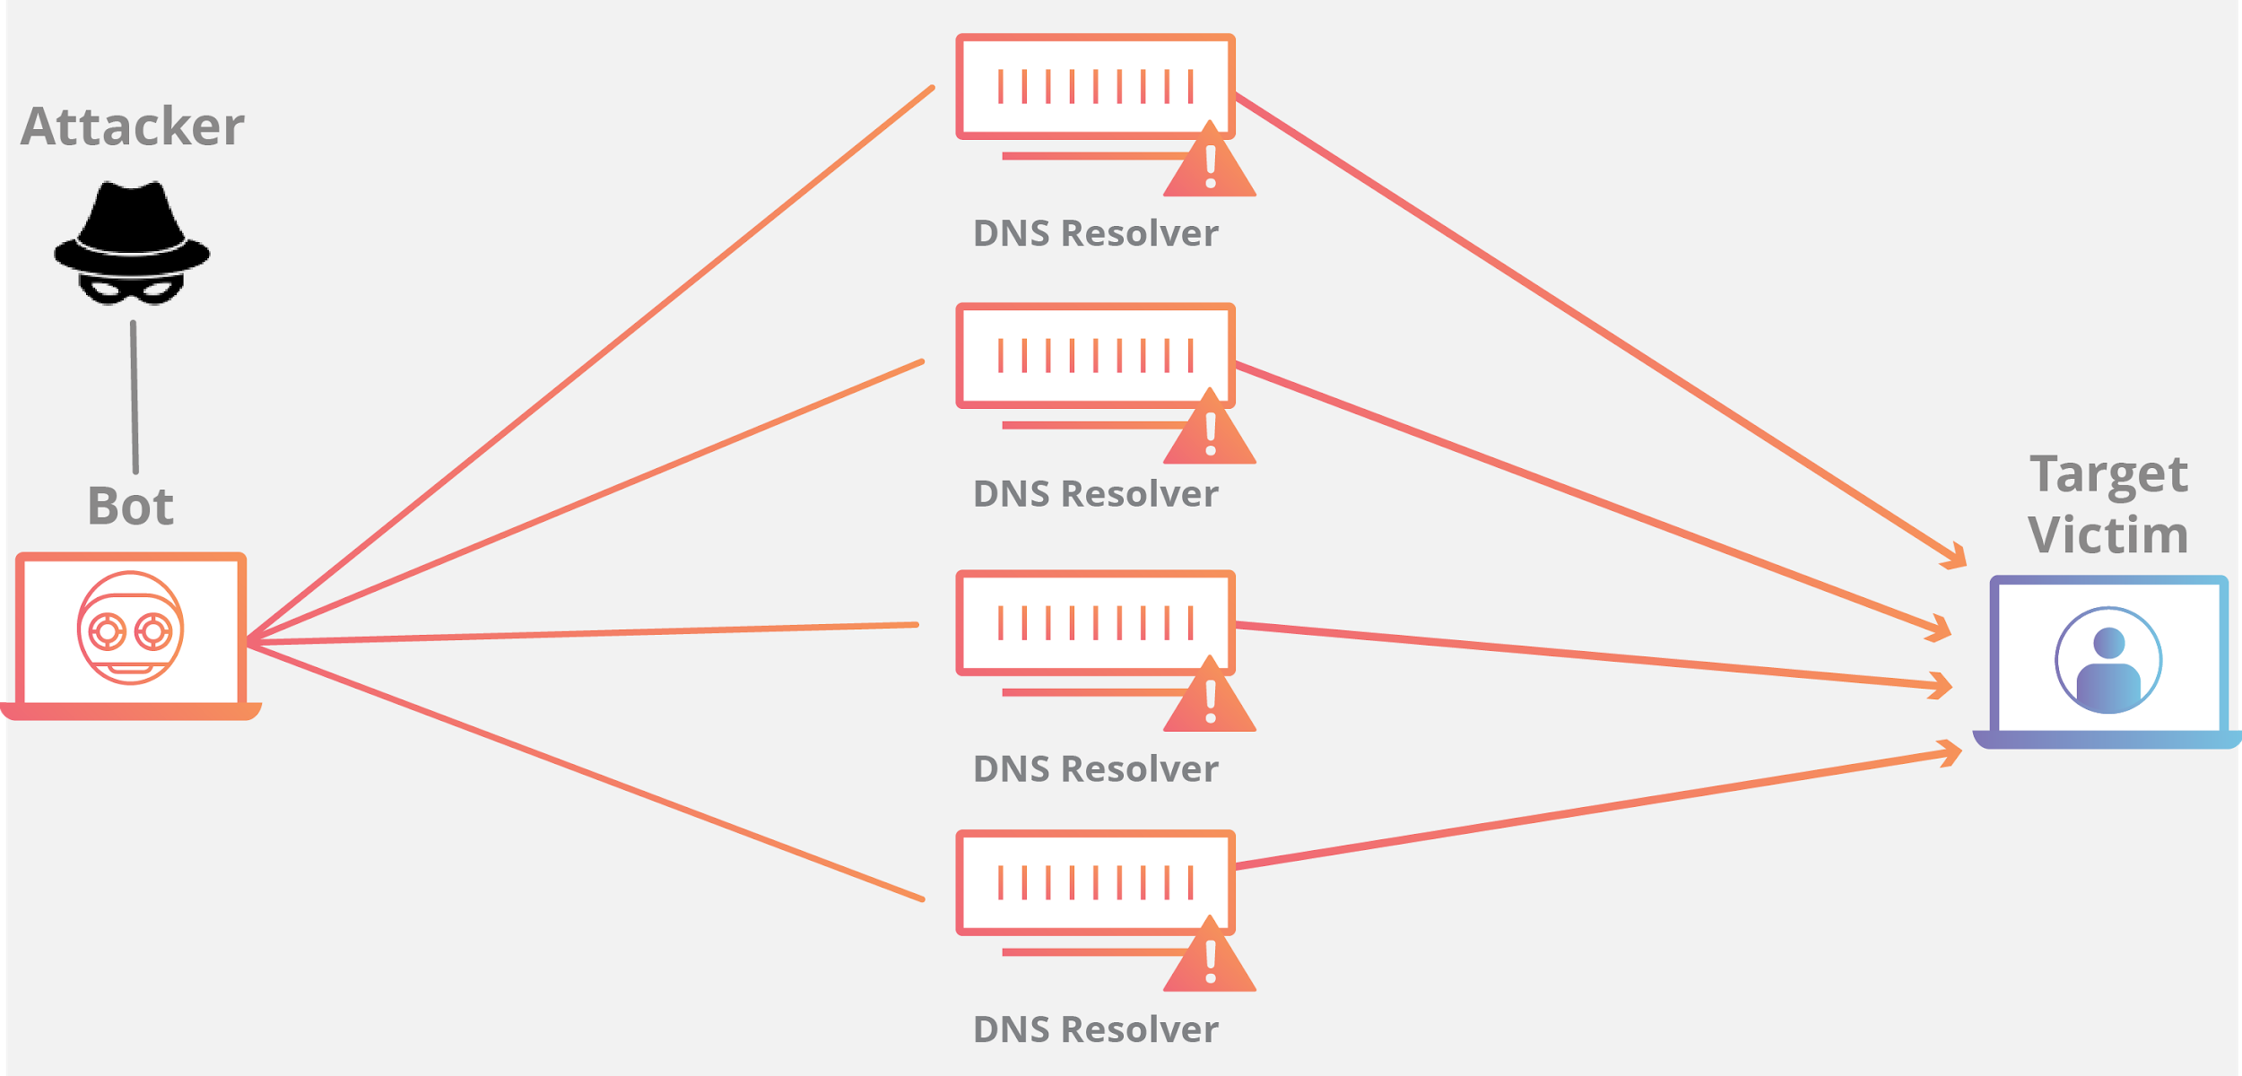
Introduction
An attacker floods an internet service with many requests in order to block traffic from legitimate users.
Three types of DDoS attacks:
Volumetric
Resource Exhaustion
Application Layer attacks

Slide 3
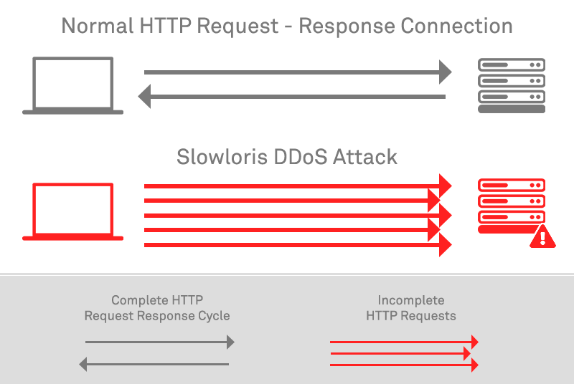
Problem
An attacker will read / write data to a server slowly, that way it keeps the connection open.

Slide 4
Objectives

Slide 5
Project resources

Slide 6
Strategy

Slide 7
Strategy

Slide 8
Demo

Slide 9
Results

Slide 10
References
S. Dantas Silva, E. Silva, E. P. Neto, M. Lemos, A. J. Venancio Neto, and F. Esposito, “A Taxonomy of DDoS Attack Mitigation Approaches Featured by SDN Technologies in IoT Scenarios,” Sensors, vol. 20, no. 11, p. 3078, May 2020.
Business, C., 2020. 12 DDoS Statistics That Should Concern Business Leaders. [online] Coxblue.com. Available at: ¡https://www.coxblue.com/12-ddos-statistics-that-should-concern-business-leaders/¿[Accessed 27 February 2021].
\bibitem{news} Cisco Visual Networking Index: Forecast and Trends (2017–2022). Available online: https://www.cisco.com/c/en/us/solutions/collateral/service-provider/visual-networking-index-vni/white-paper-c11-741490.html (accessed on 15 December 2019).
\bibitem{news1} M. V. O. Assis, L. F. Carvalho, J. Lloret, and M. L. Proenca jr., “A GRU deep learning system against attacks in software-defined networks”, Journal of Network and Computer Applications, vol. 177, p. 102942, mar. 2021, doi: 10.1016/j.jnca.2020.102942
\bibitem{news2} N. N. Tuan, P. H. Hung, N. D. Nghia, N. V. Tho, T. V. Phan, and N. H. Thanh, “A DDoS Attack Mitigation Scheme in ISP Networks Using Machine Learning Based on SDN,” Electronics, vol. 9, no. 3, p. 413, Feb. 2020, doi: 1ñ0.3390/electronics9030413
\bibitem{news4} M. P. Novaes, L. F. Carvalho, J. Lloret, and M. L. Proenca jr., “Long Short-Term Memory and Fuzzy Logic for Anomaly Detection and Mitigation in Software-Defined Network Environment”, IEEE Access, vol. 8, pp. 83765–83781, 2020, doi: 10.1109/access.2020.2992044.
\bibitem{news5}REAL security. 2019. Evolution of DDoS in the last decade - REAL security. [online] Available at: <https://www.real-sec.com/2019/08/evolution-of-ddos-in-the-last-decade/> [Accessed 19 February 2021].
\bibitem{news6} KUPREEV, O., BADOVSKAYA, E. and GUTNIKOV, A., 2021. DDoS attacks in Q2 2020. [online] Securelist. Available at: <https://securelist.com/ddos-attacks-in-q2-2020/98077/> [Accessed 20 February 2021].

